Slide 1
APPLICATION WEBSITE FOR E-SHOPPING
R.SRINIVASAN
192011239

Slide 2



FLIPKART FOUNDERS
BINNY BANSAL
SACHIN BANSAL

Slide 3
AIM
TO ANALYSE E-COMMERCE APPLICATION FOR FLIPKART.

Slide 4
E-COMMERCE FLIPKART BUSINESS MODEL
To purchase product on flipkart
Sign in to your flipkart account.
Click on a category. When you find an item you want, click on it.
Review the item, and click Add to Cart.
Click Proceed to Checkout.
Enter a shipping address and click Continue.
Choose a payment method and click Continue.
Click Place Your Order.

Slide 5
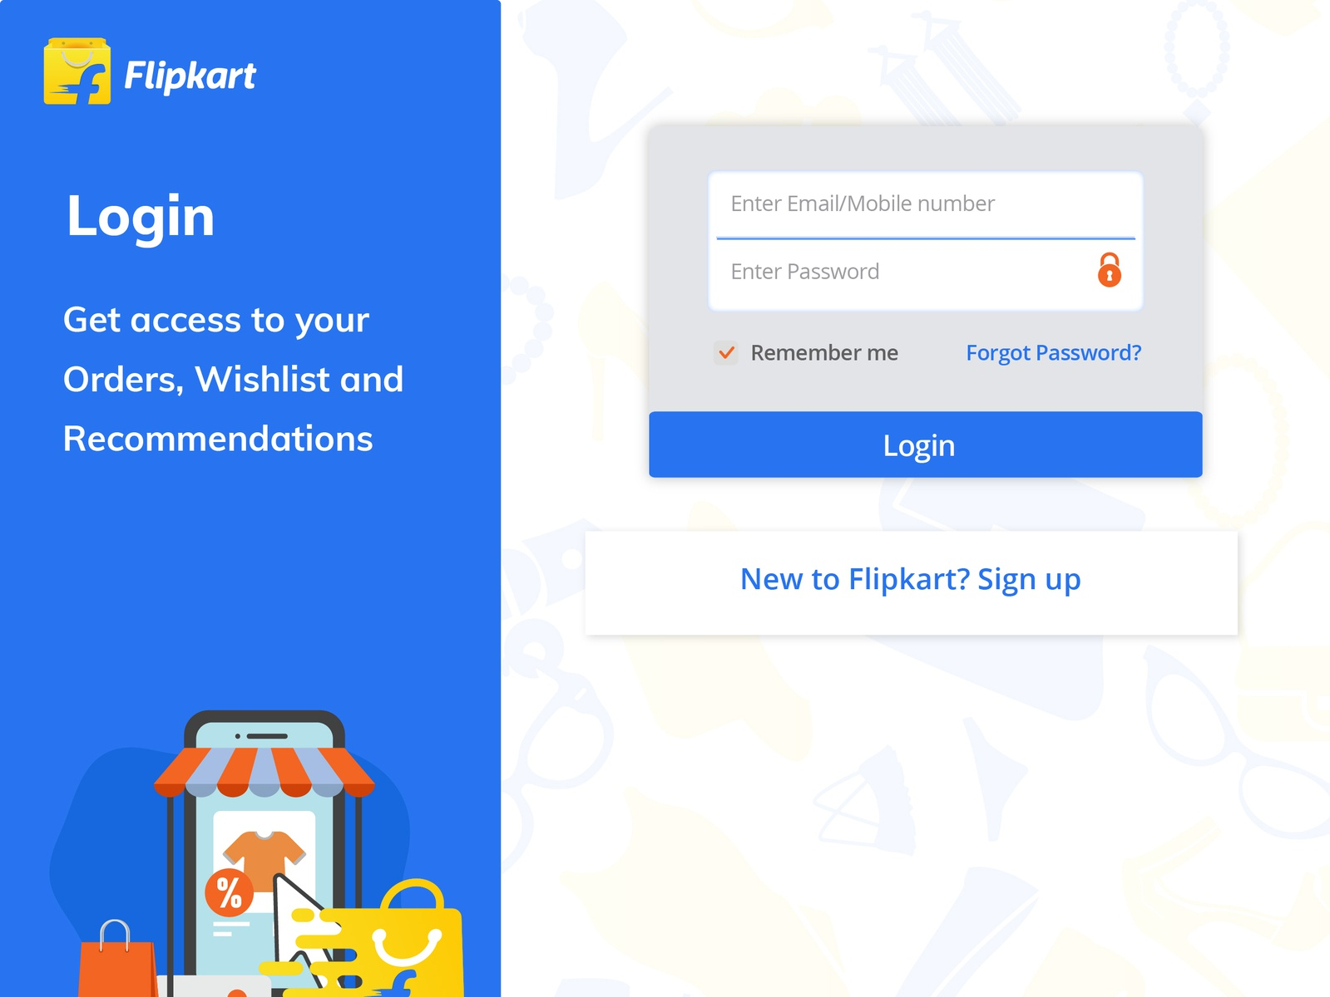
INSTRUCTIONS ON HOW TO BUY A PRODUCT ON FLIPKART
1. Sign into your flipkart account.
Go to www.flipkart.com in your web browser and log in. To do this, move your mouse over “Hello, Sign In” and click Sign In. Then click in the boxes highlighted in the right screenshot below and type in your email address and account password, respectively. Finally, click Sign In Using Our Secure Server.

Slide 6
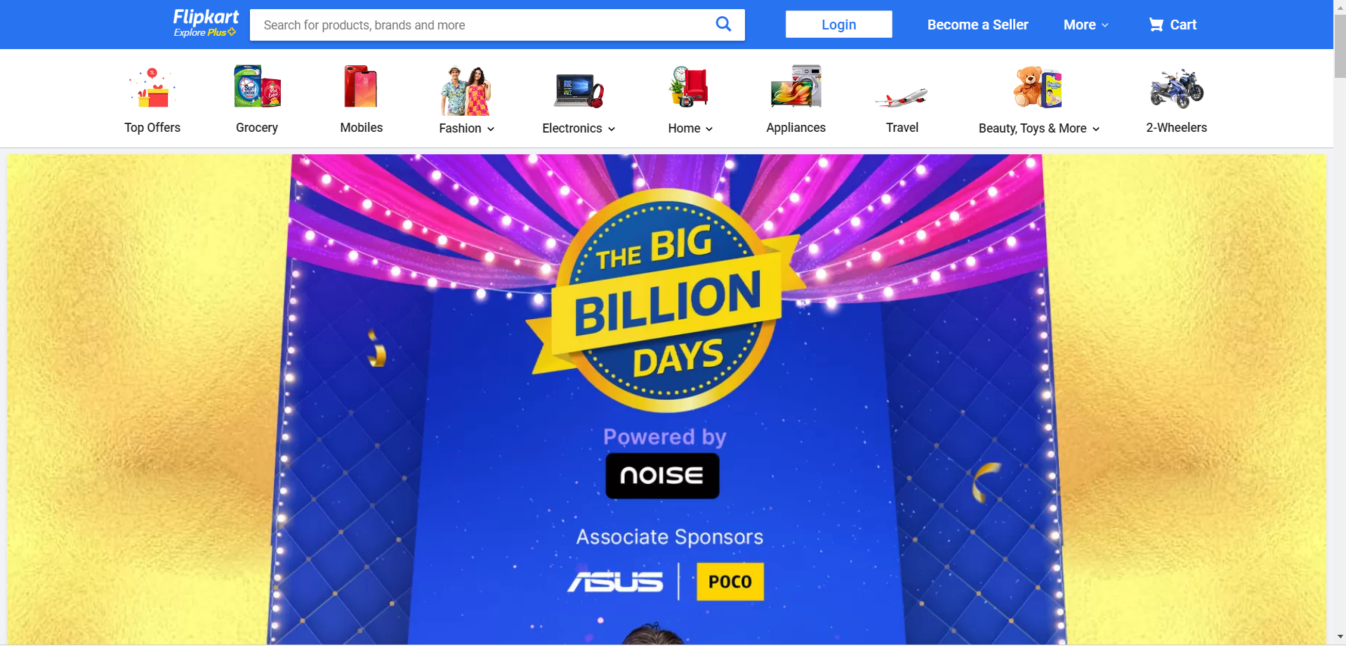
2.SEARCH THROUGH CATEGORIES.
We can search through the categories wise like the image show in the above.
1.If we selecting the grocery means the items will display.
2. If we selecting fashion products it wil shows all the sub-categories like men , women and kids product.
3.Like this all the main categories has a sub categories to search items easily.

Slide 7
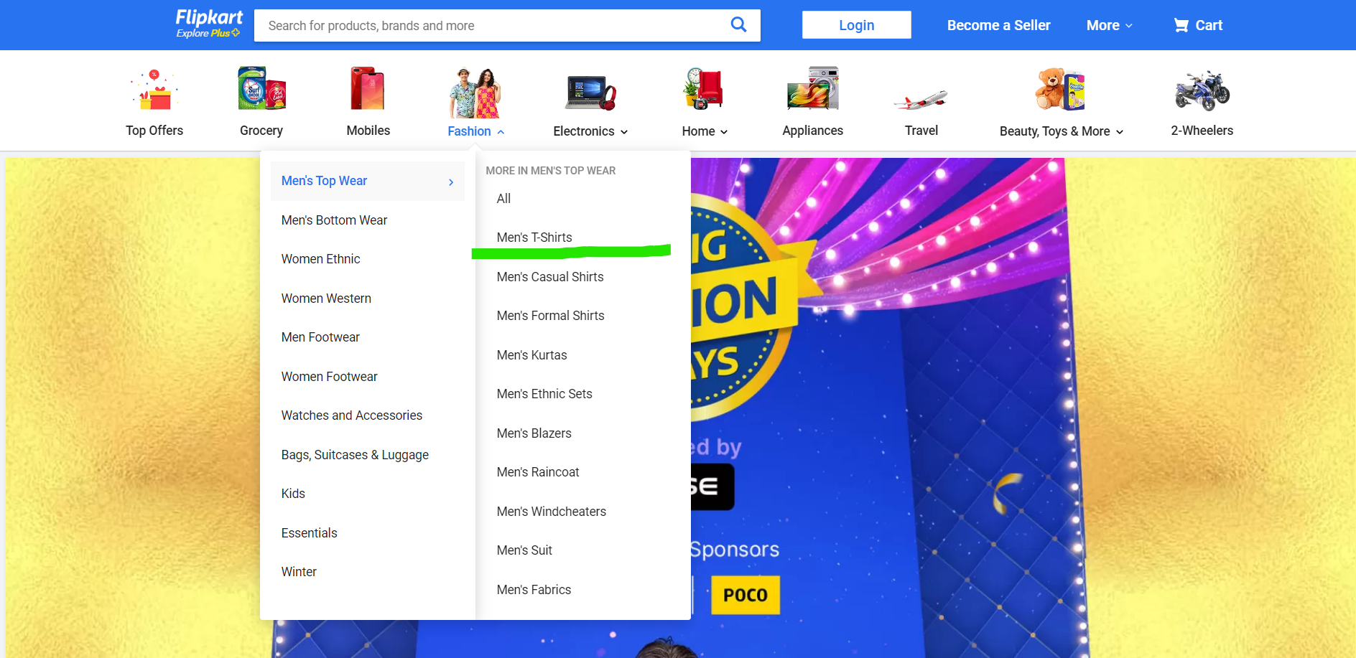
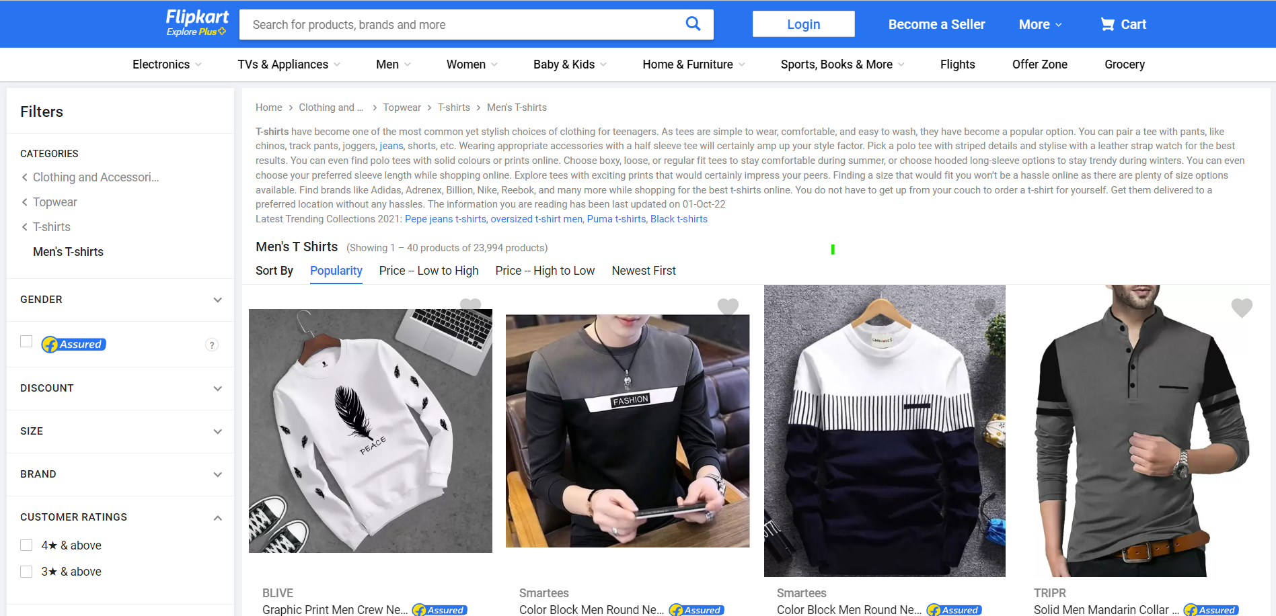
3.FIND A SPECIFIC CATEGORY
Now,let’s click on the Men’s wear and click men’s t-shirt.
Then, the Men’s shirt will appears on the screen.

Slide 8
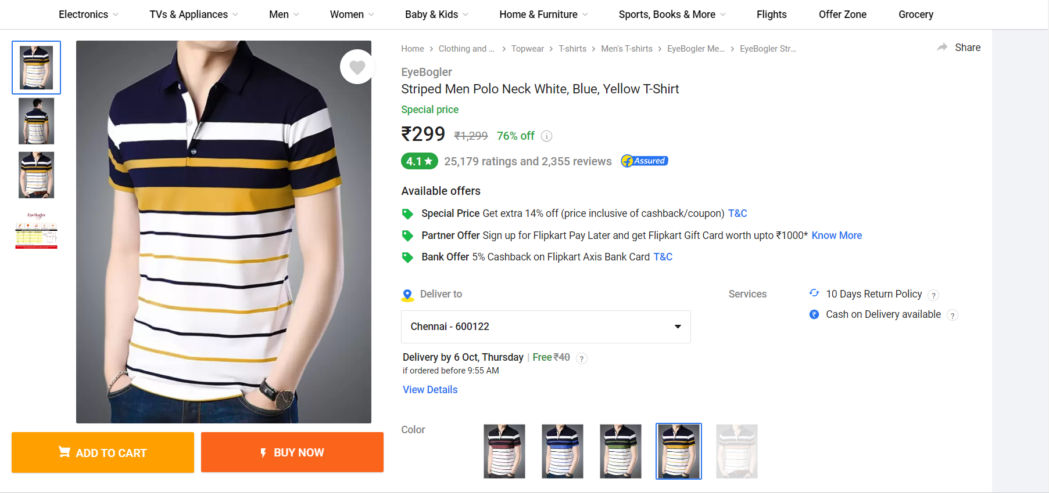
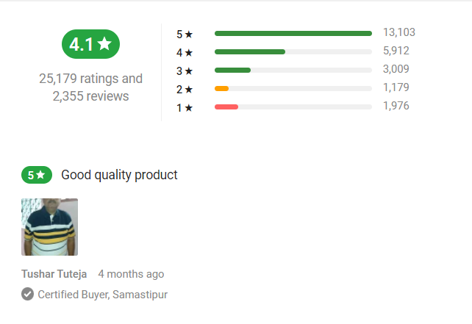
4.VIEW AND SELECT AN ITEM
You’ll now see the Men’s T-shirt available.

Slide 9
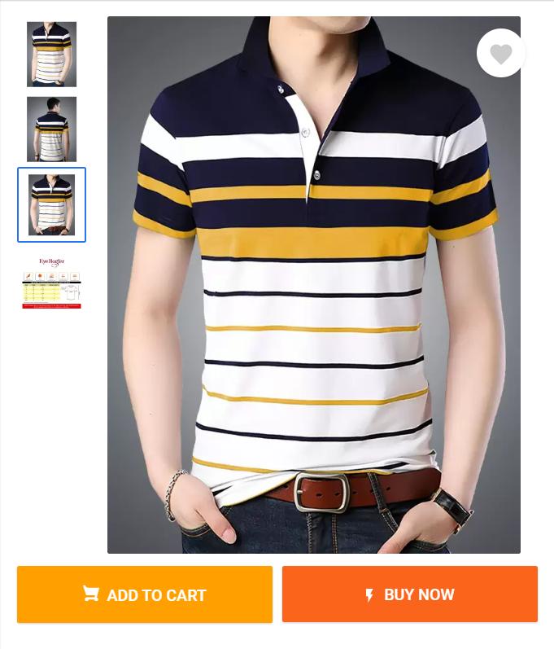
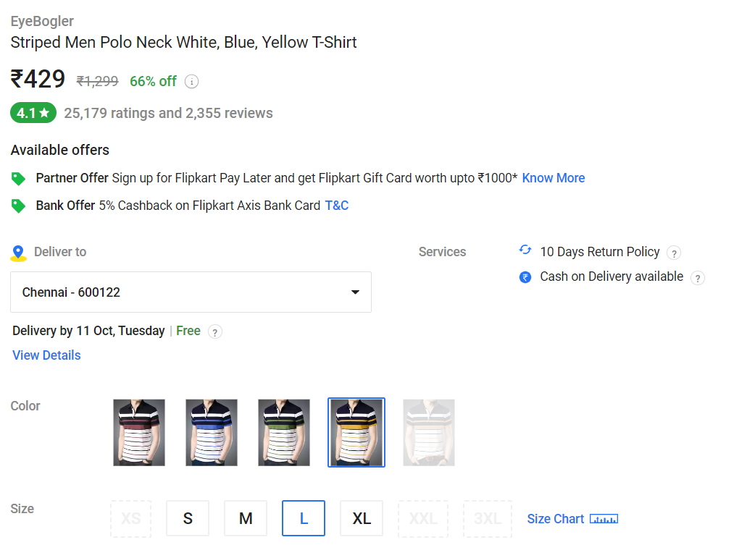
5. ADD ITEM TO THE CART
Here, you’ll see some more detailed information about the product you’ve selected. If you’ve decided that it’s what you want.
And select the size, color and check the delivery date to your pincode.
Then click Add to Cart.

Slide 10
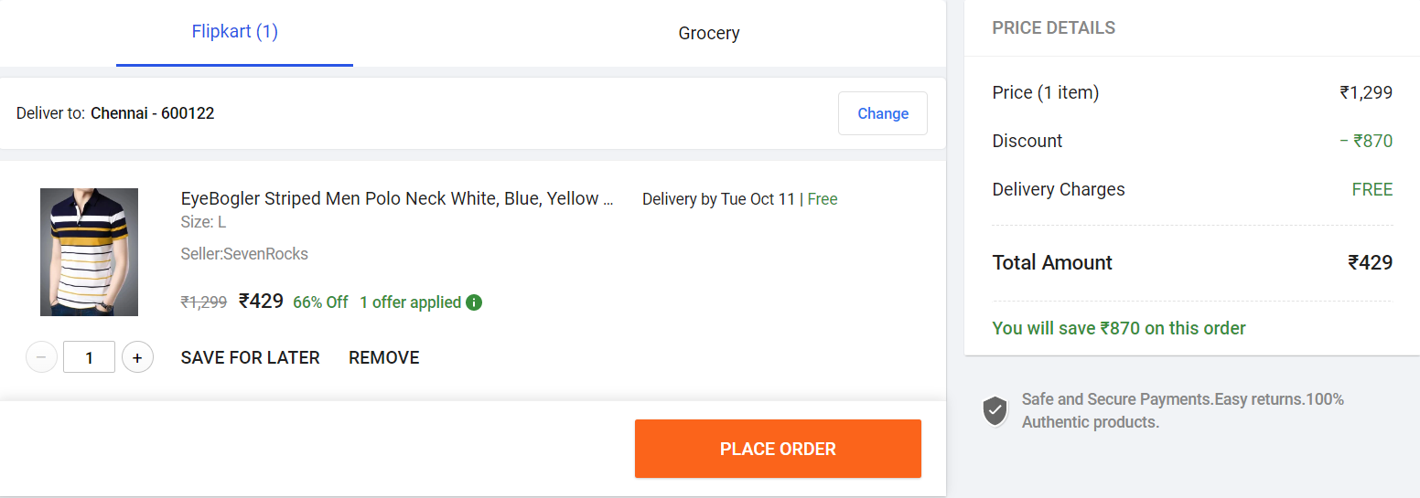
6.Proceed to the checkout
If this is the only thing you want to buy , then click Place order.

Slide 11
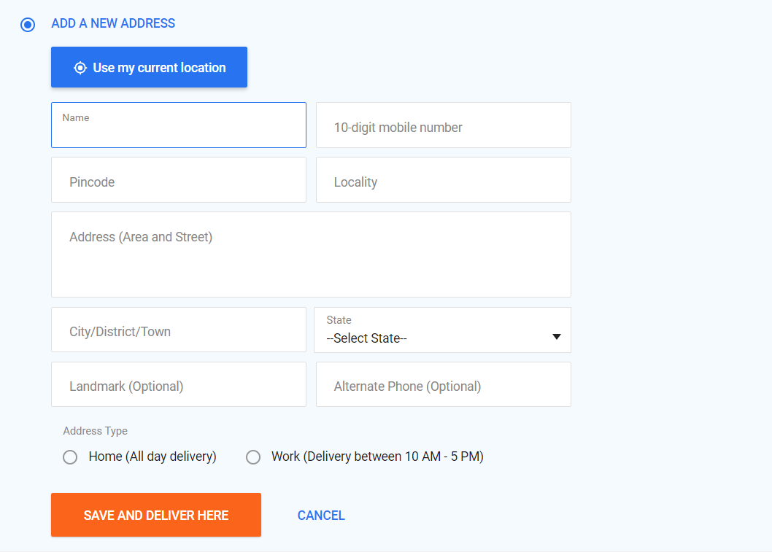
7.ENTER THE ADDRESS
You’ll now have to pick an address to send your delivery to. If you don’t have one, you’ll have to create a new one.

Slide 12
Click in each of the boxes “Enter A New Shipping Address” and type in or select:
Your full name
Your street address
Your unit address (if you live in an apartment, condo, etc.)
The city in which you live
The state, province, or region in which you live
Your Pincode.
The country in which you live
Your phone number
And you can select the address type like home or work .
According the address type the package will deliver on time.

Slide 13
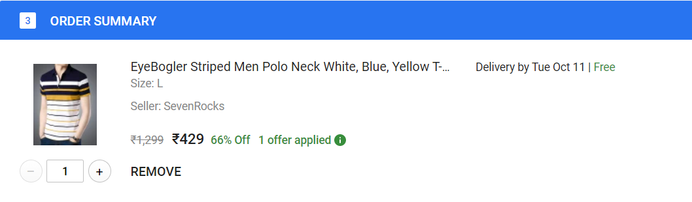

8.ORDER SUMMARY
Now you can see your order summary.
The item details like price, size and the seller details also visible on the site.
Also you can select number of quantity needed.
Finally, click continue.

Slide 14
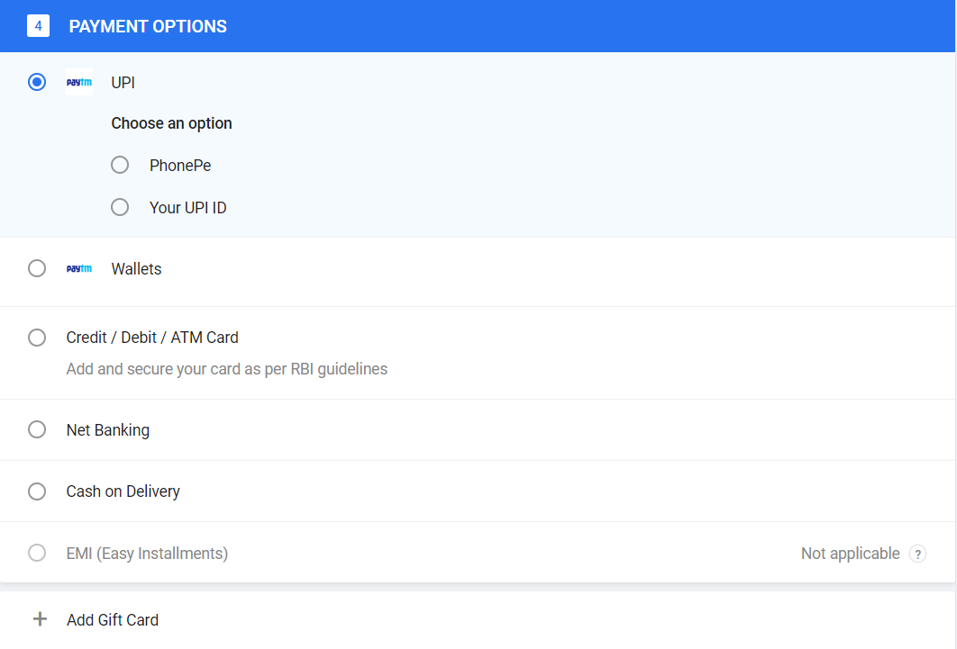
9.CHOOSE A PAYMENT MENTHOD
Now you have to select a method of paying for your product ordered.
Then place the order.

Slide 15
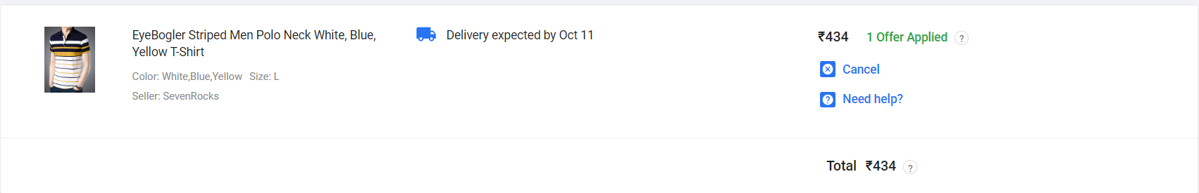
10. ORDERED DETAILS
After all these process your order will shows the
The delivery date
Price and
Cancellation.

Slide 16
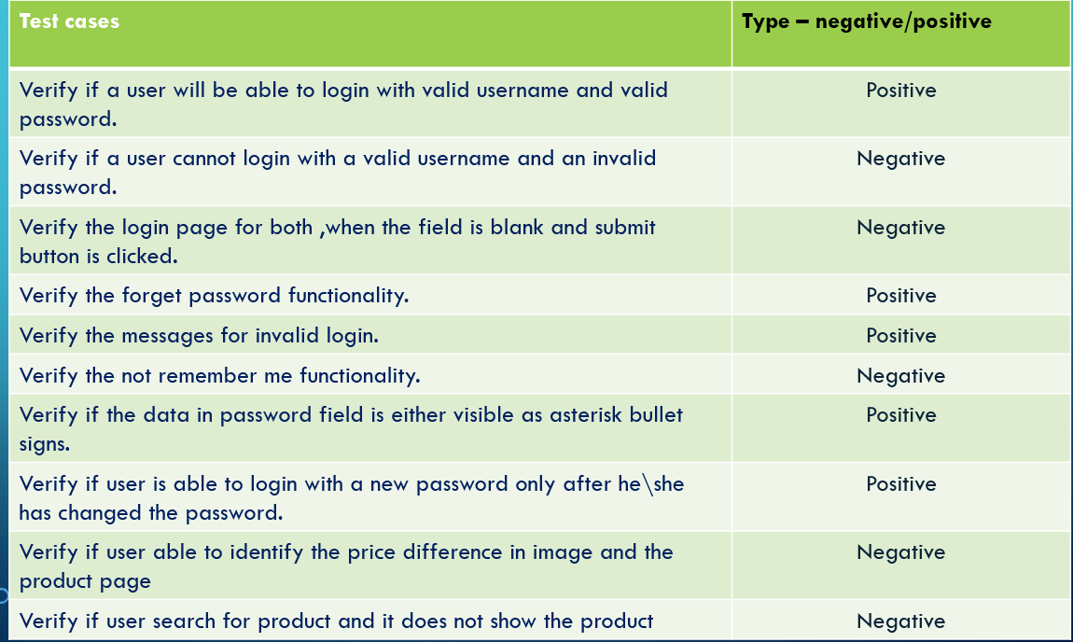
TEST CASES

Slide 17
CONCLUSION
It can be said that Flipkart is the current market global, digital, and constantly expanding.
It is an increasingly productive brand, which adapts quickly to new demands, in a fast, effective and original way.
For this reason, even though it faces competition on all its fronts, individually, its corporate umbrella remains unparalleled and therefore, must remain in the lead, for years to come.

Slide 18


